Slide 1
MA3077 (DLI) Operational Research Lecture 16 – Queueing Theory
Dr Marco Fasondini

Slide 2
Recapitulation and lecture outline
Summary: in the previous lectures we learnt the theory and some applications of linear programming.
In this lecture: Queueing Theory (following closely Ch. 17 of the book by Hillier and Lieberman).

Slide 3
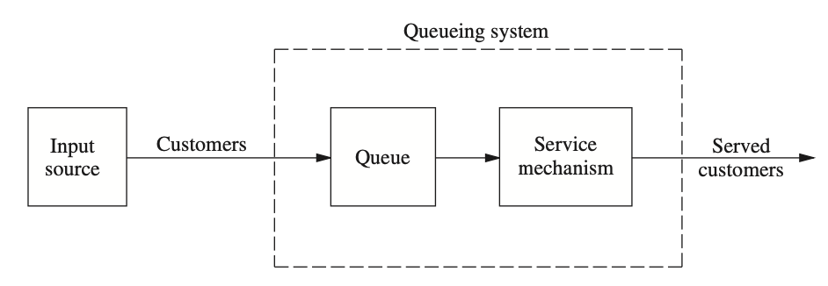
Basic structure of queueing models
Model: An input source generates customers, who enter the queueing system to access a service and join a queue if service is not immediately available. A queue discipline prescribes when a queue member can access the service mechanism, which provides the desired service. After that, the customer leaves the queueing system.

Slide 4
The input source (calling population)
Definitions:
Customers arrive from the so-called calling population.
Its size is the total number of customers who will eventually access the service. This can be either infinite (easier model, default option) or finite (more technical, because the number of customers in the queue affects the number of potential new customers).
Customers are generated according to a rule (often a stochastic process).
Assumption: Customers are generated one at a time. The time between consecutive arrivals is called interarrival time. Often it is further assumed that customer generation is not affected by the length of a queue (no balking).

Slide 5
The queue and the queue discipline
The queue is where customers wait before being served. Often, it is assumed that the only way out is by being served (no reneging).
A key property of a queue is how many customers it can contains simultaneously.
Modelling with an infinite queue is easier, because the queue status (called length) does not affect the input source.
The queue discipline indicates the order in which members of the queue are selected for service. The most common model is first-come-first-served (known as FIFO: first-in-first-out). Other modelling options are also possible, e.g., at random, or according to some priority procedure.
Example: the waiting room of an A&E unit cannot contain infinitely many patients (they are very rarely turned away, but often discouraged to visit), and it operates a queue discipline based on order of arrival and gravity of the patients' conditions.

Slide 6
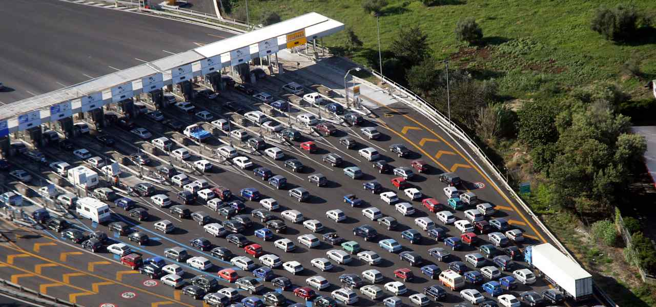
The service mechanism
The service mechanism consists of one or more service facilities (in series).
Each service facility contains one or more parallel service channels, the servers.
Simple models have only one service facility with possibly more than one server.
The service time is how long a server needs to deliver the service. This is commonly drawn from a probability distribution (which may depend both on the service specifics and the customer type).
Source: https://tinyurl.com/tollboothpic

Slide 7
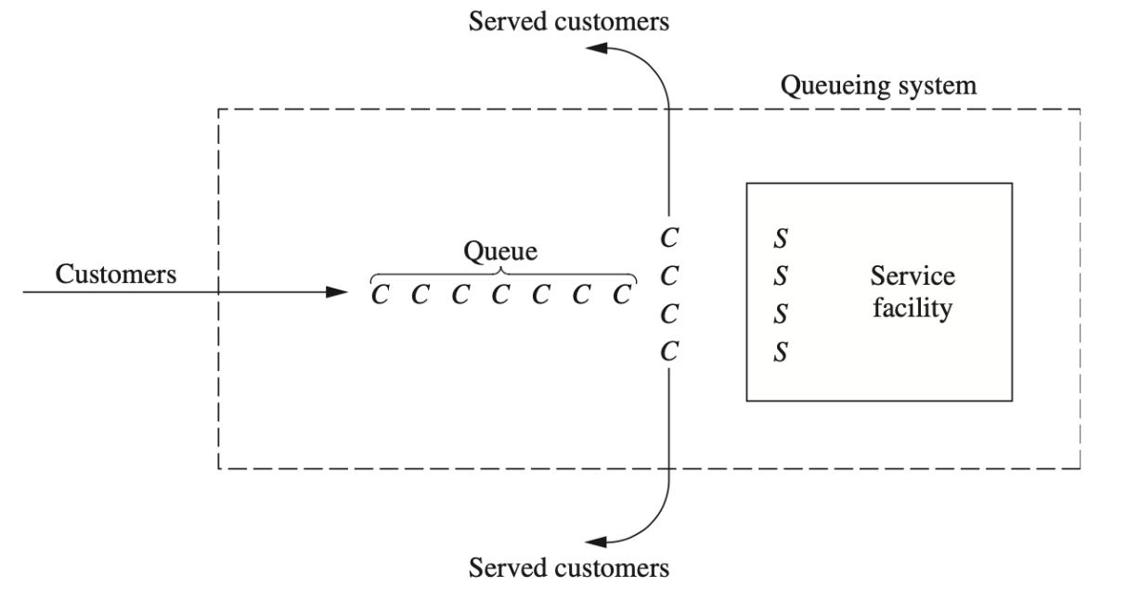
Elementary queue model
Scenario: A single waiting line (possibly empty at times) in the front of a single service facility with one or more servers. Each customer generated by an input source is serviced by one of the servers after waiting in the queue (waiting line).

Slide 8
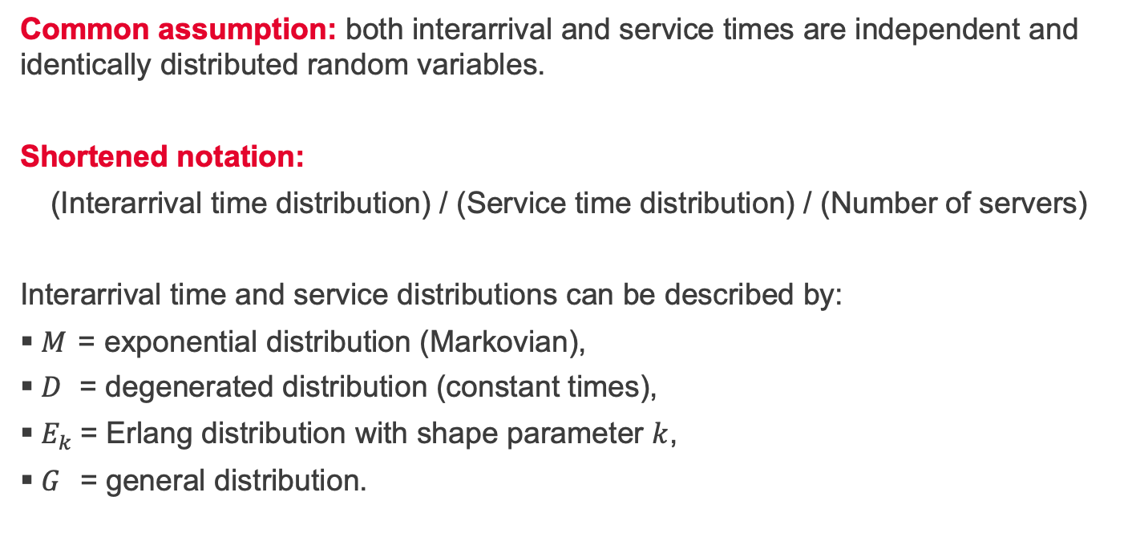
Elementary queue model – shortened notation
Common assumption: both interarrival and service times are independent and identically distributed random variables.
Shortened notation:
(Interarrival time distribution) / (Service time distribution) / (Number of servers)
Interarrival time and service distributions can be described by:
$M$ = exponential distribution (Markovian),
$D$ = degenerated distribution (constant times),
$E_{k}$= Erlang distribution with shape parameter $k$,
$G$ = general distribution.

Slide 9
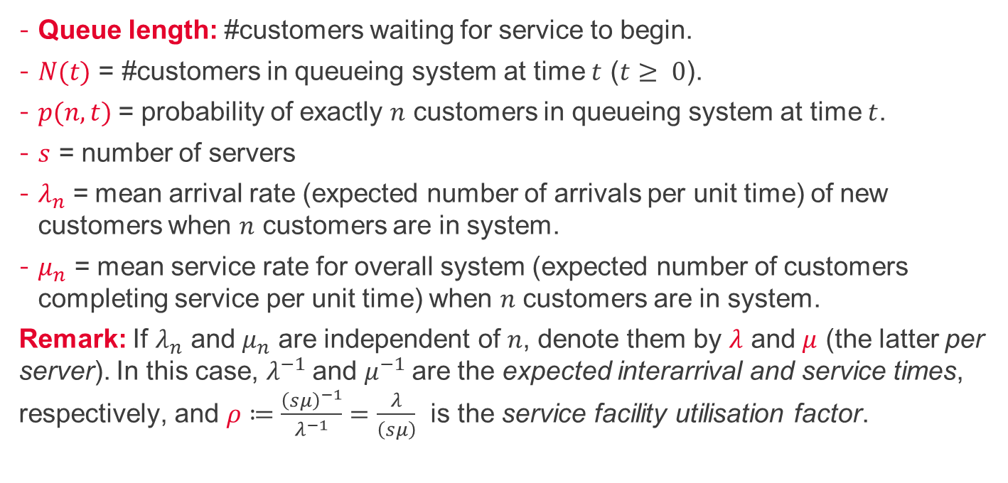
Terminology and Notation
Queue length: #customers waiting for service to begin.
$N(t)$ = #customers in queueing system at time $t$ ($t≥ 0$).
$p(n,t)$= probability of exactly $n$ customers in queueing system at time $t$.
$s$ = number of servers
$λ_{n}$= mean arrival rate (expected number of arrivals per unit time) of new customers when $n$ customers are in system.
$μ_{n}$ = mean service rate for overall system (expected number of customers completing service per unit time) when $n$ customers are in system.
Remark: If $λ_{n}$ and $μ_{n}$ are independent of $n$, denote them by $λ$ and $μ$ (the latter per server). In this case, $λ^{−1}$and $μ^{−1}$are the expected interarrival and service times, respectively, and $ρ≔\frac{{\left(sμ\right)}^{−1}}{λ^{−1}}=\frac{λ}{\left(sμ\right)}$ is the service facility utilisation factor.

Slide 10
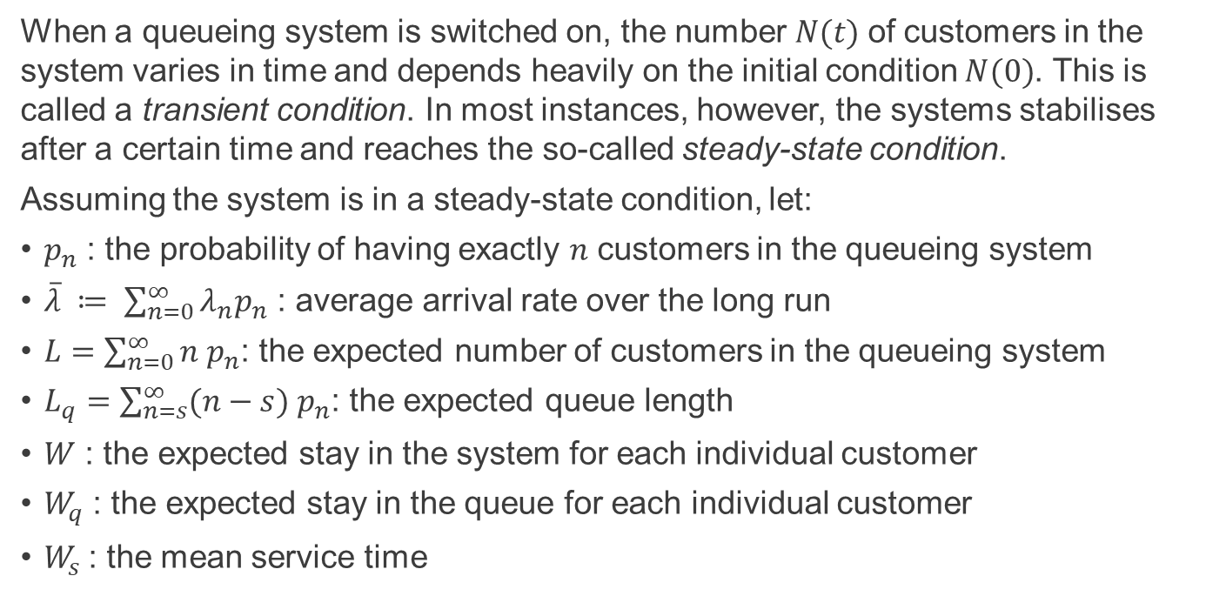
Transient and steady-state conditions
When a queueing system is switched on, the number $N(t)$of customers in the system varies in time and depends heavily on the initial condition $N(0)$. This is called a transient condition. In most instances, however, the systems stabilises after a certain time and reaches the so-called steady-state condition.
Assuming the system is in a steady-state condition, let:
$p_{n}$ : the probability of having exactly $n$ customers in the queueing system
$\overline{λ} ≔ \sum_{n=0}^{∞}{λ_{n}p_{n}}$ : average arrival rate over the long run
$L=\sum_{n=0}^{∞}{n p_{n}}$: the expected number of customers in the queueing system
$L_{q}=\sum_{n=s}^{∞}{(n−s) p_{n}}$: the expected queue length
$W$ : the expected stay in the system for each individual customer
$W_{q}$ : the expected stay in the queue for each individual customer
$W_{s}$: the mean service time

Slide 11
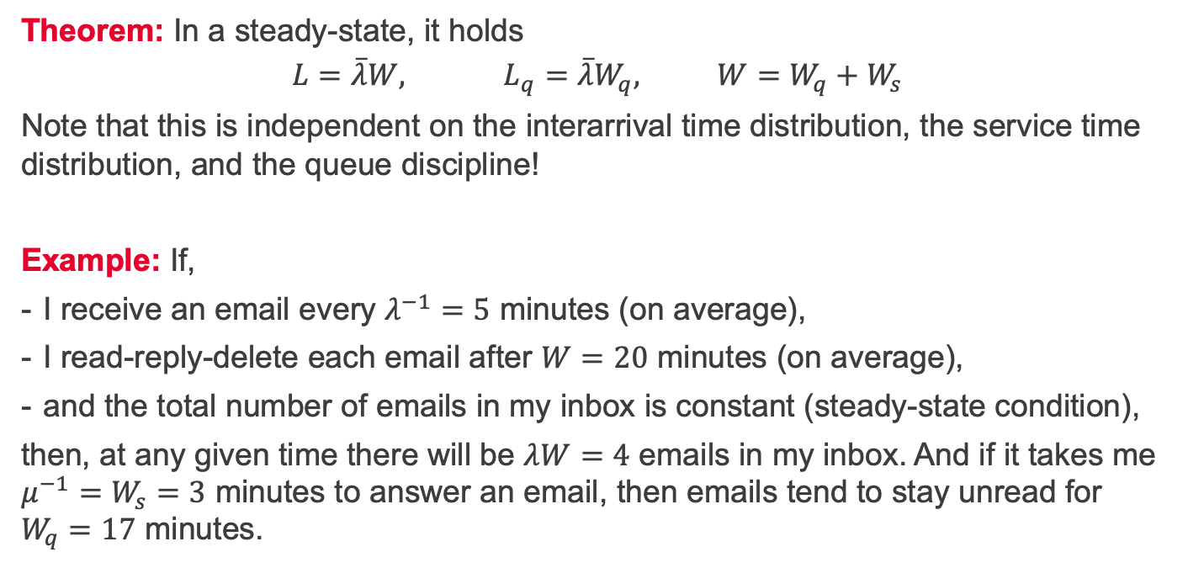
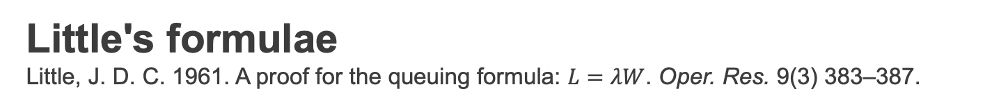
Little's formulae Little, J. D. C. 1961. A proof for the queuing formula: $L=λW$. Oper. Res. 9(3) 383–387.
Theorem: In a steady-state, it holds
$$L=\overline{λ}W, L_{q}=\overline{λ}W_{q}, W=W_{q}+W_{s}$$
Note that this is independent on the interarrival time distribution, the service time distribution, and the queue discipline!
Example: If,
I receive an email every $λ^{−1}=5$ minutes (on average),
I read-reply-delete each email after $W=20$ minutes (on average),
and the total number of emails in my inbox is constant (steady-state condition),
then, at any given time there will be $λW=4$ emails in my inbox. And if it takes me $μ^{−1}=W_{s}=3$ minutes to answer an email, then emails tend to stay unread for $W_{q}=17$ minutes.

Slide 12
Summary and self-study
Summary: today we have learnt:
the basic principles of queueing theory,
how to use Little's formula for steady states.
Self-study: Create your own queue problem and use Little's formula to determine the average number of customers in the queueing system.

